Slide 1
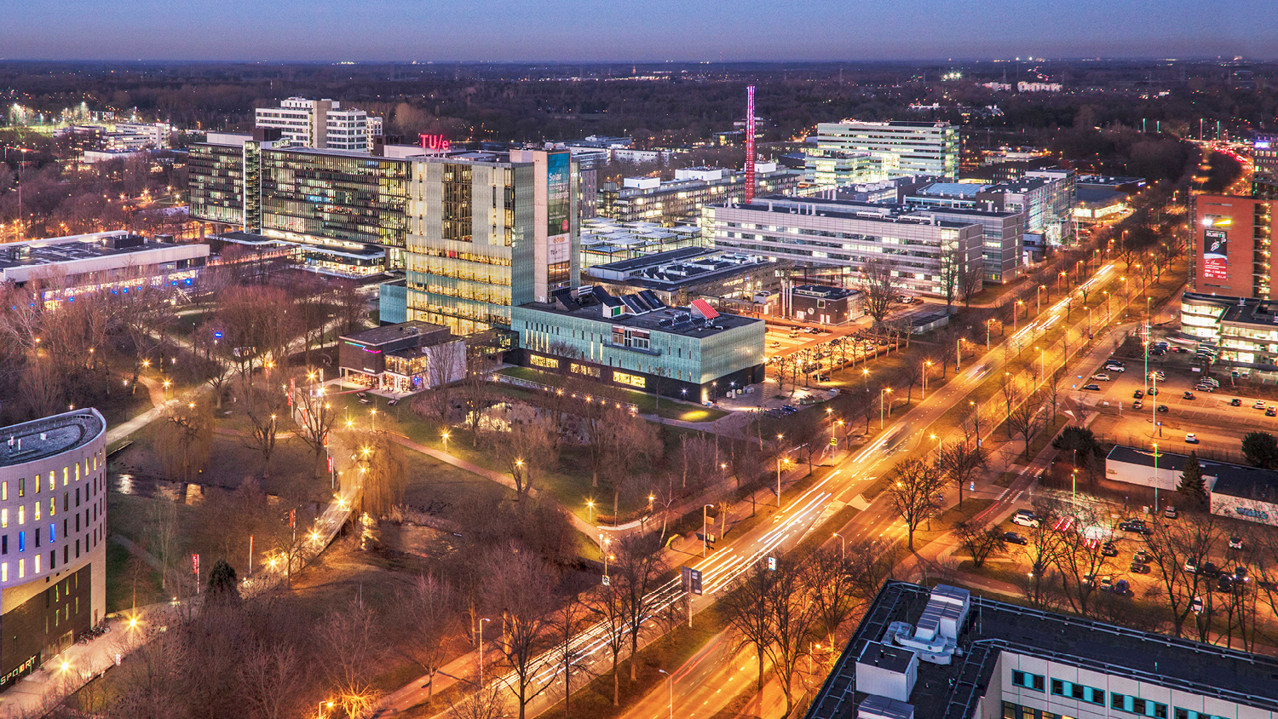
Combustion Engine-4GB10-Interim Presentation
5th of March 2021
Team 007: Lars van Alen, Thomas Driessen, Dolf Eck, Vito Fransen, Mats van der Heijden, Joey Janssen, Alexandra Văcaru, Mihai-Dragoş Ungureanu
Department, Sub department or Capacity Group

Slide 2
Planning of the presentation
I. Introduction
II. Our Initial Approach
III. Research
A. Thermodynamics & Engine Combustion
B. Bio-Fuels
C. PV diagram
IV. Experiments
A. Setup
B. Results
V. Future Plans
VI. Question Round
C. Current Analysis

Slide 3

I. Introduction
A gardening company GroenDoen (fictious) decided to opt for a using a greener fuel
A team of 8 people will focus on analyzing this green fuel and see how it react with the Honda GX200 engine
Deadline for the project 19th of March.

Slide 4
II. Our Initial Approach
First a planning + Gantt Chart were made
Secondly each team member did an RPC List (but it was decided to do not use it)
Thirdly, a collaboration platform was made where planning can be seen and working together on code is possible (Gitkraken)
Fourthly, team roles were distributed on a weekly basis

Slide 5
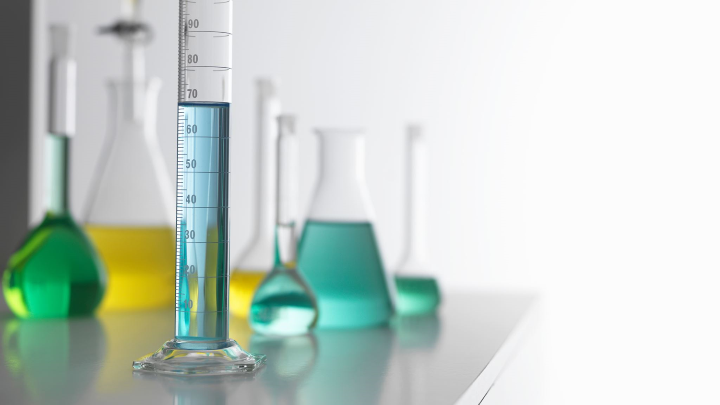
III. Research
5
Combustion Engine-4GB10-Interim Presentation-2021

Slide 6
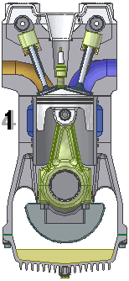
A. Thermodynamics & Engine Combustion
combustion engine type used for the project: Otto combustion engine (air-fuel is ignited with a spark)
The engine operates under the Otto cycle:
The air-fuel mixtures comes in the combustion chamber
The mixture is compressed by the piston
Spark plug ignites the compressed mixture
Ignited mixture is then used as power (piston pushed down)
Left-over exhaust gasses are pushed out of the combustion chamber by the piston

Slide 7
B. Bio-Fuels vs Normal Fuel
Normal Fuel (Gasoline)
Gasoline is manufactured from crude oil (distillation)
A special compound is added that reduces emissions and increase mileage
Several additives might be added for increased performances
Bio-Fuels (Ethanol)
Bio-ethanol is produced either from corn, sugar plants or starch (fermentation)
Ethanol is added to the normal fuel
High octane number thus self ignition is reduced
Notes:
The bio-ethanol has also some cons:
Based on water, meaning it does not combine quite good with oil thus the 2 can disassociate which leads to:
Corrosion
Gasoline will go on top because is oil and ethanol on the bottom meaning that the gasoline will lose a lot of RON points making the fuel less efficient and more damaging than normal fuel

Slide 8
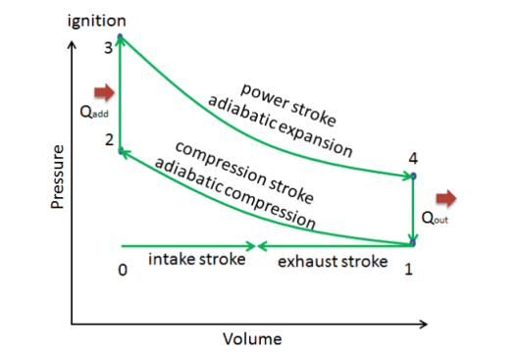
C. PV Diagram
Describes the corresponding changes in volume and pressure in the system
Determine the efficiency of the engine
Allows to make statements about the internal energy, heat transferred and worked done on a gas

Slide 9
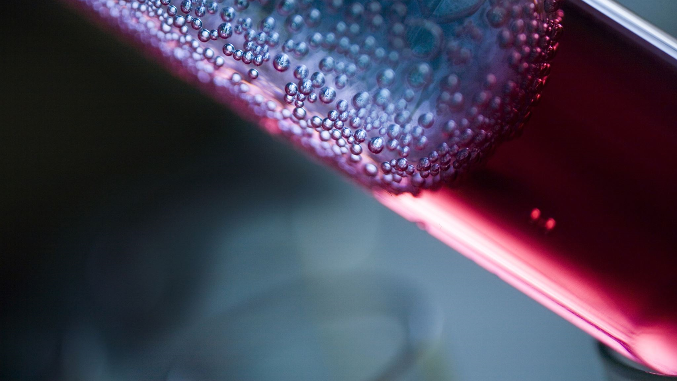
IV. Experiments
9
Combustion Engine-4GB10-Interim Presentation-2021

Slide 10
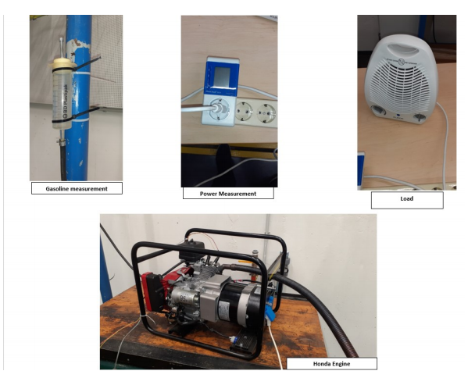
A. Setup
The setup was composed of a Honda GX200 engine
The load was a fan connected to the engine and to a power measurement (for power consumption)
The fuel was transmitted to the engine using the gasoline measurement tube

Slide 11
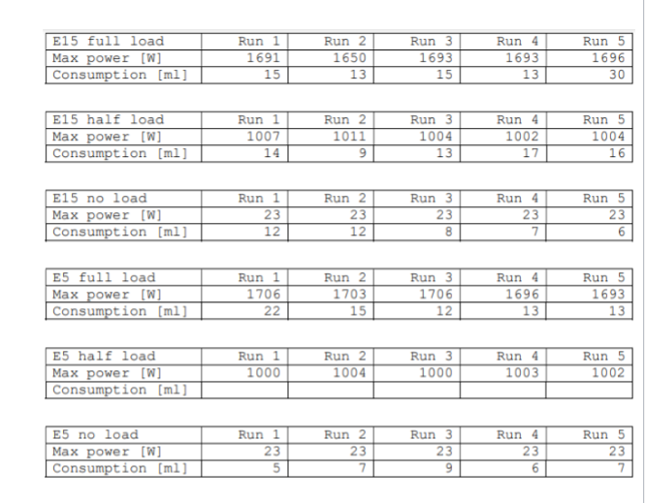
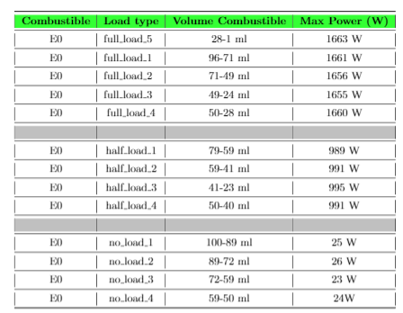
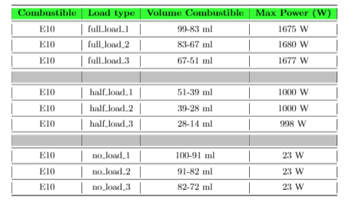
B. Results
2 test were conducted
1st test, 2 types of gasoline were used E0 (3 runs each) and E10 (4 runs each) and 3 load scenario were conducted (no load, half-load, full-load)
2nd test, 2 types of gasoline were used E5 and E15 using the same load scenario, 5 times each

Slide 12
C. Current Analysis
PV diagrams can be computed from the measured data
The double tooth can be determined from the pulse and pressure graphs
Fuel efficiency can now be calculated

Slide 13
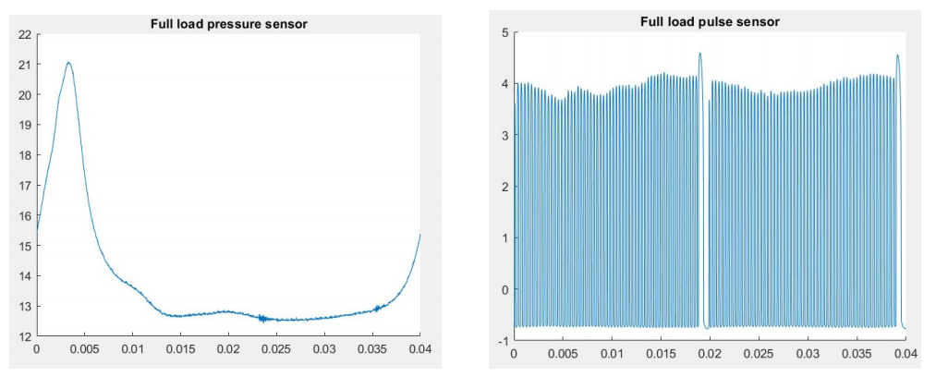
Pulse and Pressure Graphs (full load)
Notes:
To analyze and determine the phase of the engine, an examination of the pressure and pulse graph is needed
During a full cycle the crank rotates 720 degrees meaning that the double tooth passes by the pulse sensor twice in a full cycle.
This is the reason why in the pulse graph, the double tooth is present twice in a cycle

Slide 14
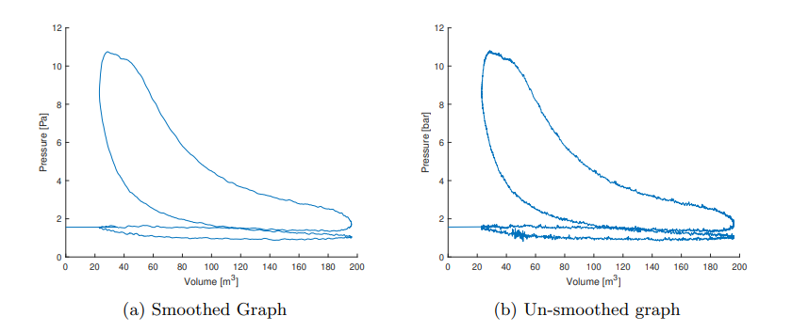
PV Diagram (half load)
Notes:
lines are not so smooth and the edges not that crisp.
What also can be noticed is the pressure below 1 atmosphere (1013 PA) in the bottom of the graph. That means that the fuel mixture is literally sucked into the cylinder compartment.
- The intake and exhaust stroke also don’t walk exact the same route, that could be very logical, but that is not the same as a theoretical model.
- All these small differences can be seen as imperfections in the model.

Slide 15

V. Future plans
15
Combustion Engine-4GB10-Interim Presentation-2021

Slide 16
Future implementations
Compare all the datasets that we have of the different type of fuels and see which one performs the best
Improve the PV diagram in order to be as precise as possible to the theoretical model
Make an analysis and complete the report

Slide 17

V. Any Questions?
17
Combustion Engine-4GB10-Interim Presentation-2021

